Slide 1
Discrete Mathematics
Dr. Han Huang
South China University of Technology
1

Slide 2
Chapter 4. Graphs
Planar Graph
Section 4.7
2

Slide 3
Contents
1
Introduction of Planar Graph
2
Euler’s Formula
3
Kuratowski’s Theorem
3

Slide 4
Introduction of Planar Graph
4

Slide 5
In this section we will study the question of whether a graph can be drawn in the plane without edges crossing?
In particular, we will answer the houses-and-utilities problem.

Slide 6
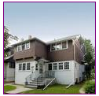


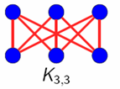



Planar graph without edges crossing ?

Slide 7
Definition 1
A graph is called planar if it can be drawn in the plane without any edges crossing (where a crossing of edges is the intersection of the lines or arcs representing them at a point other than their common endpoint).
Such a drawing is called a planar representation of the graph.

Slide 8
Example 1
K4 is planar because it can be drawn without crossing.

Slide 9
Example 2
Q3 is planar because it can be drawn without crossing.
Notes:
已修改

Slide 10
Example 3
v1
v2
v3
v4
v5
v6
(v2, v4), (v3, v4), (v3, v5), (v2, v5)

Slide 11
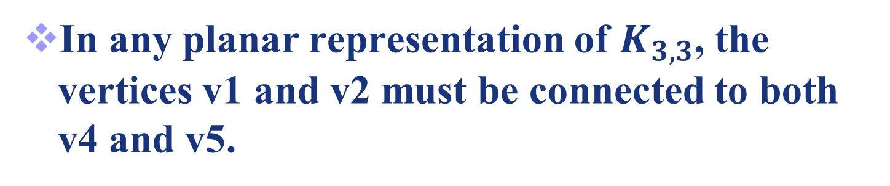
v1
v2
v3
v4
v5
v6
v4 and v5

Slide 12
v1
v2
v1
v2
v3
R21
R1
R2
R22
v4
v5
v4
v5
These four edges form a cure that splits the plane into two regions R1 and R2.
The vertex v3 is in either R1 or R2. When v3 is in R2, its incident edges separate R2 into R21 and R22

Slide 13
v1
v2
v6
v3
R21
R1
R2
v6
R22
v6
v4
v5
Whenever v6 is in R1, R21 or R22, its incident edges cannot be draw without crossing.

Slide 14
Planar graph without edges crossing ?
Therefore, three houses and three utilities cannot be connected in the plane without crossing.

Slide 15
Application of planar graph
Planarity of graphs play an important role in the design of electronic circuits.
We can model a circuit with a graph by representing components of the circuit by vertices and connections between them by edges.
We can print a circuit on a single board with no connections crossing if the graph representing the circuit is planar.

Slide 16
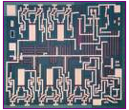

Application of planar graph
When this graph is not planar, we must turn to more expensive options. We need construct the circuit using multiple layer.

Slide 17
Euler’s Formula
17
17

Slide 18
A planar representation of a graph splits the plane into regions, including an unbounded region.
R4
R2
R3
R6
R1
R5

Slide 19
R4
R2
R3
R6
R1
R5
Euler showed that all planar representations of a graph split the plane into the same number of regions.
He found a relation among the number of regions, the number of vertices, and the number of edges of a planar graph.

Slide 20
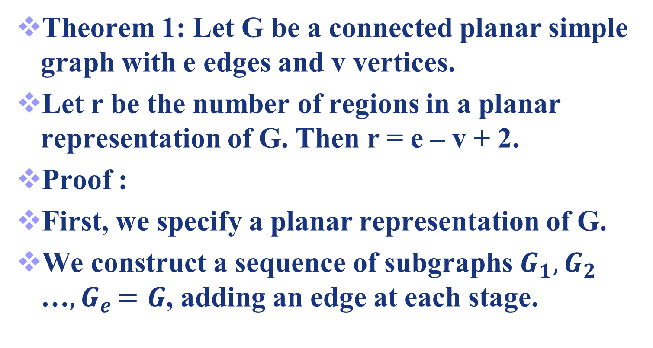
Euler’s Formula

Slide 21
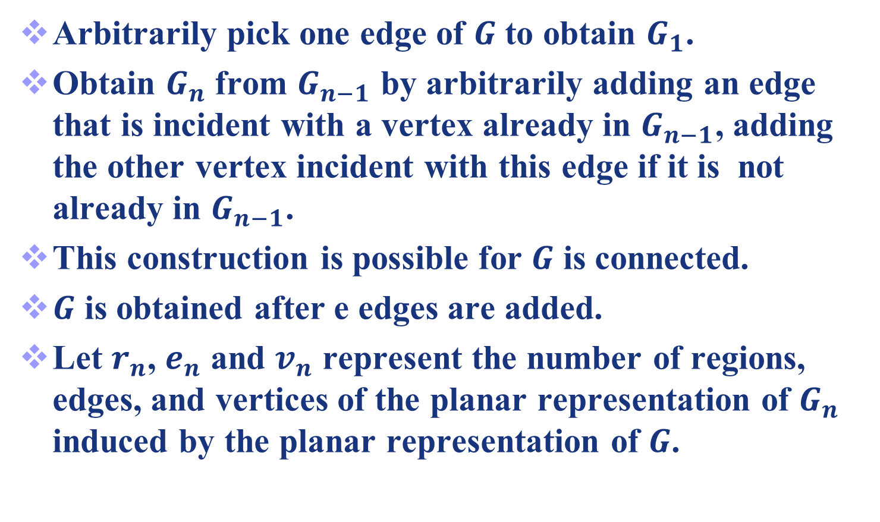
Euler’s Formula

Slide 22
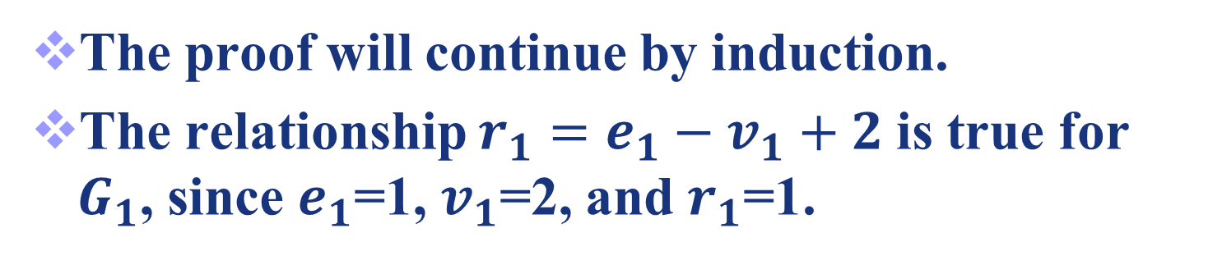



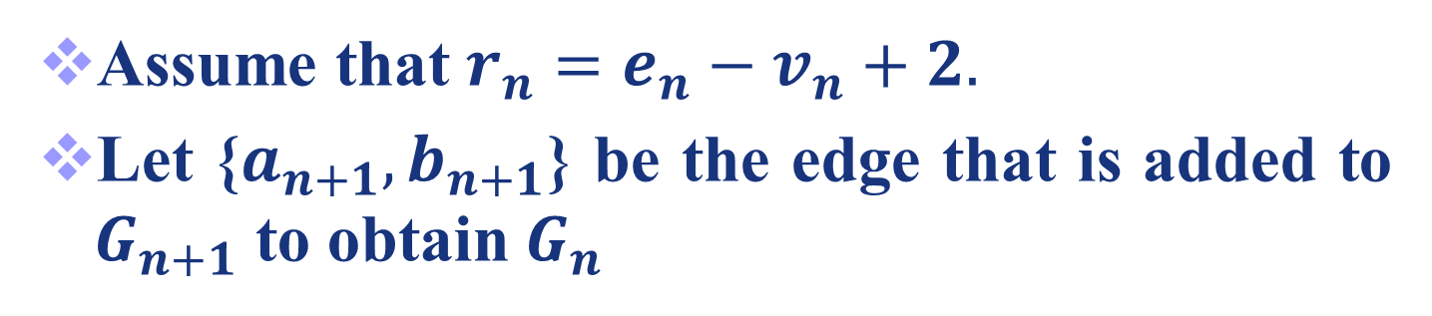
Euler’s Formula
Assume that $r_{n}=e_{n}−v_{n}+2.$
Let {$a_{n+1},b_{n+1}$} be the edge that is added to $G_{n+1}$ to obtain $G_{n}$

Slide 23

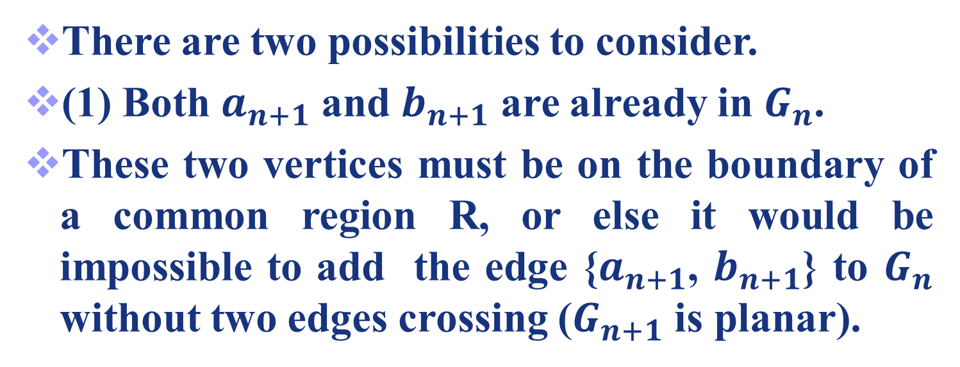

Euler’s Formula
There are two possibilities to consider.
(1) Both $a_{n+1}$ and $b_{n+1}$ are already in $G_{n}$.
These two vertices must be on the boundary of a common region R, or else it would be impossible to add the edge {$a_{n+1}$, $b_{n+1}$} to $G_{n}$ without two edges crossing ($G_{n+1}$ is planar).
$$a_{n+1}$$
R
$$b_{n+1}$$

Slide 24
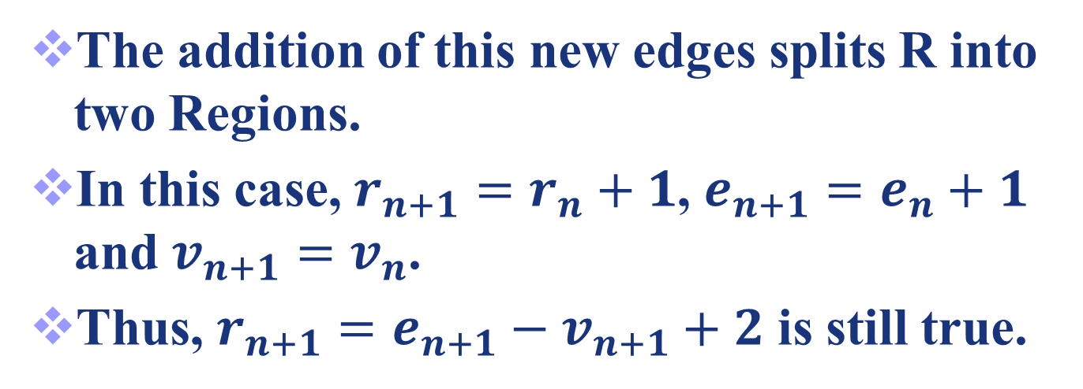
$$a_{n+1}$$
R
$$b_{n+1}$$

Slide 25


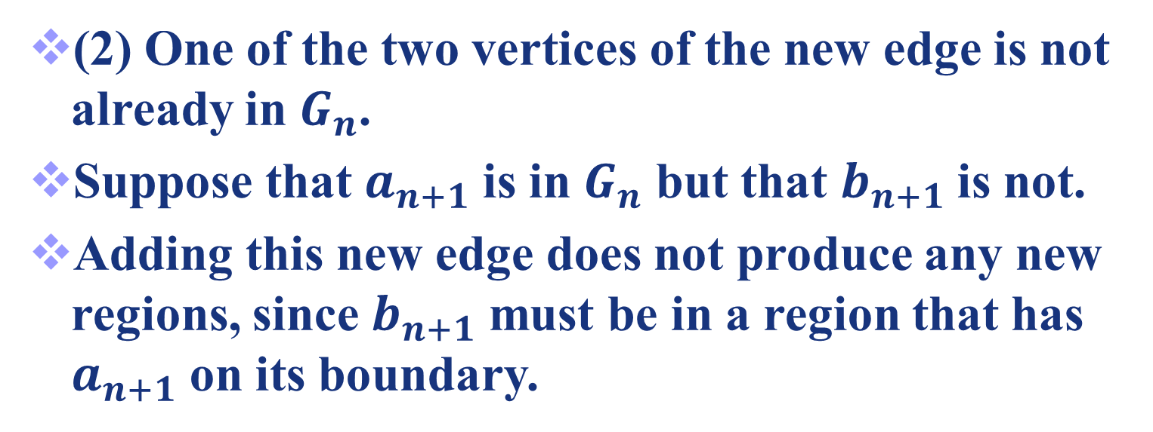
Euler’s Formula
(2) One of the two vertices of the new edge is not already in $G_{n}$.
Suppose that $a_{n+1}$ is in $G_{n}$ but that $b_{n+1}$ is not.
Adding this new edge does not produce any new regions, since $b_{n+1}$ must be in a region that has $a_{n+1}$ on its boundary.
$$a_{n+1}$$
R
$$b_{n+1}$$

Slide 26
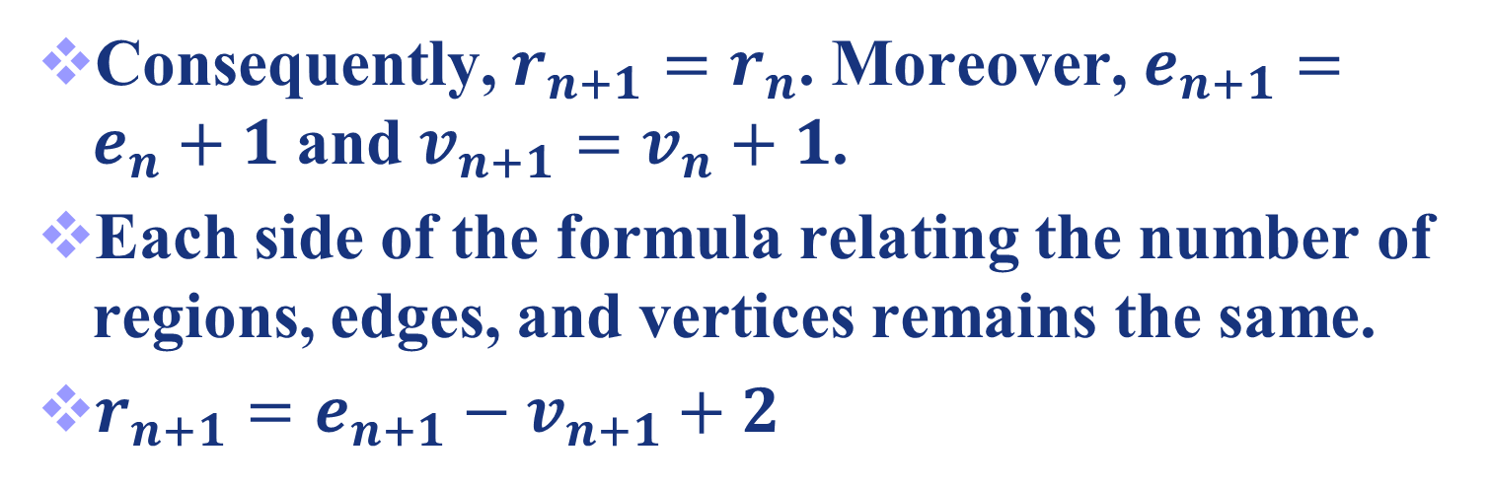


Euler’s Formula
$$a_{n+1}$$
R
$$b_{n+1}$$

Slide 27
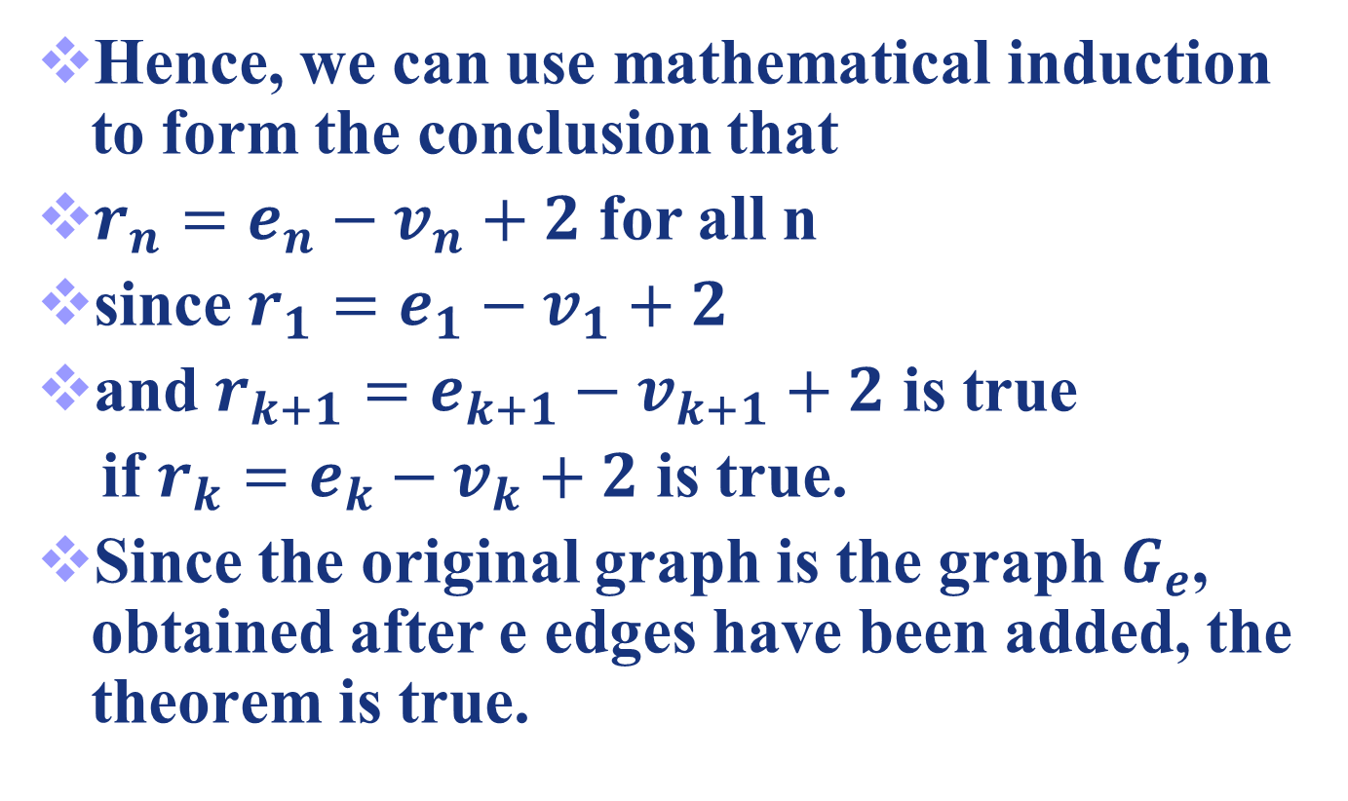
Euler’s Formula

Slide 28
Example 4
Suppose that a connected planar simple graph has 15 vertices, each of degree 4.
Because 2e = 15 * 4 =60, e =30.
Hence, r = e – v + 2 = 30 - 15 +2 = 17.

Slide 29
Corollary 1
Corollary 1: If G is a connected planar simple graph with e edges and v vertices where v ≥ 3, then e ≤ 3v -6.
Proof: A connected planar simple graph drawn in the plane divides the plane into r regions.
The degree of each region is at least three.
In particular, the degree of the unbounded region is at least three since there are at least three vertices in the graph.

Slide 30
Corollary 1
Proof: The sum of the degrees of the regions is exactly twice the number of edges in the graph, because each edge occurs on the boundary of a region exactly twice.
Since each region has degree greater than or equal to three, it follows that

Slide 31
Corollary 1

Slide 32
Corollary 2
Corollary 2: If G is a connected planar simple graph, then G has a vertex of degree not exceeding five.
Proof: If G has one or two vertices, the result is true. If G has at least three vertices, by Corollary 1 we have that
If the degree of every vertex were at least six,
Thus, G has a vertex with degree no greater than 5.

Slide 33
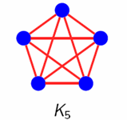
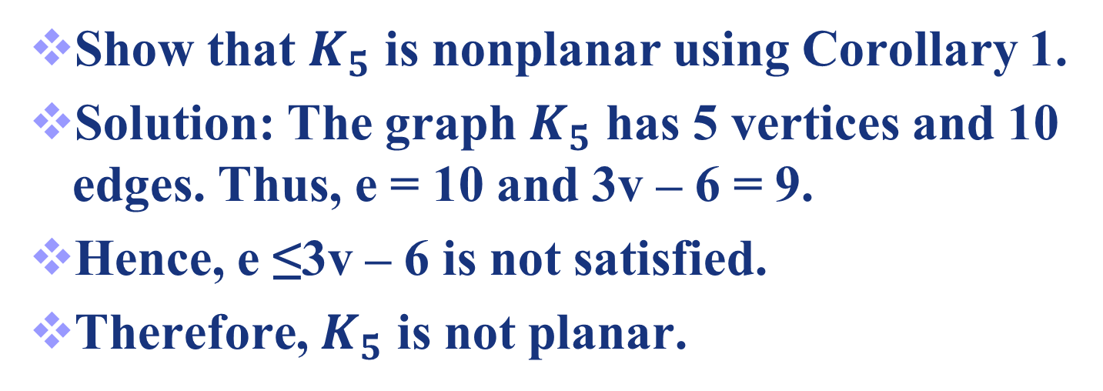
Example 5

Slide 34
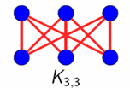
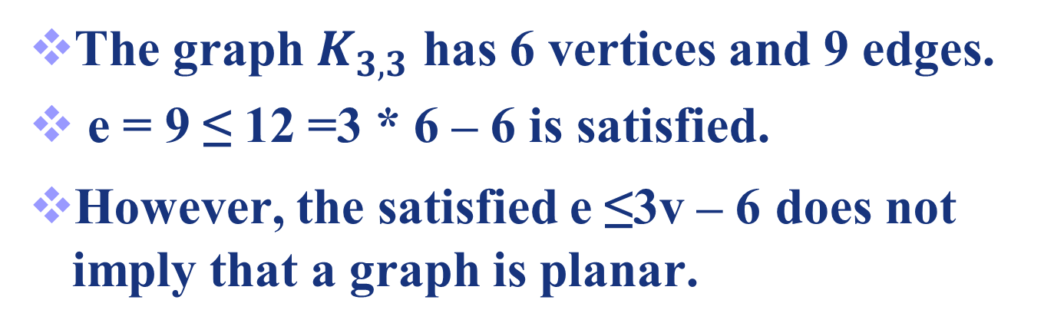
Another Example

Slide 35
Corollary 3
Corollary 3: If G is a connected planar simple graph has e edges and v vertices with v ≥ 3 and no circuits of length three, e ≤ 2v - 4.
Proof: A connected planar simple graph drawn in the plane divides the plane into r regions.
The degree of each region is at least 4.
In particular, the degree of the unbounded region is at least 4 since there are at least 4 vertices in the graph.

Slide 36
Corollary 3
Proof: The sum of the degrees of the regions is exactly twice the number of edges in the graph,
because each edge occurs on the boundary of a region exactly twice.
Since each region has degree greater than or equal to 4, it follows that

Slide 37
Corollary 3

Slide 38
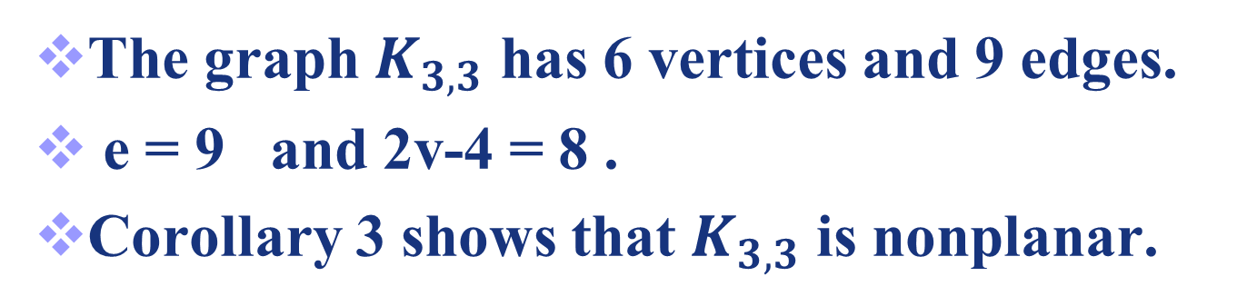
Another Example

Slide 39
Kuratowski’s Theorem
39
39

Slide 40
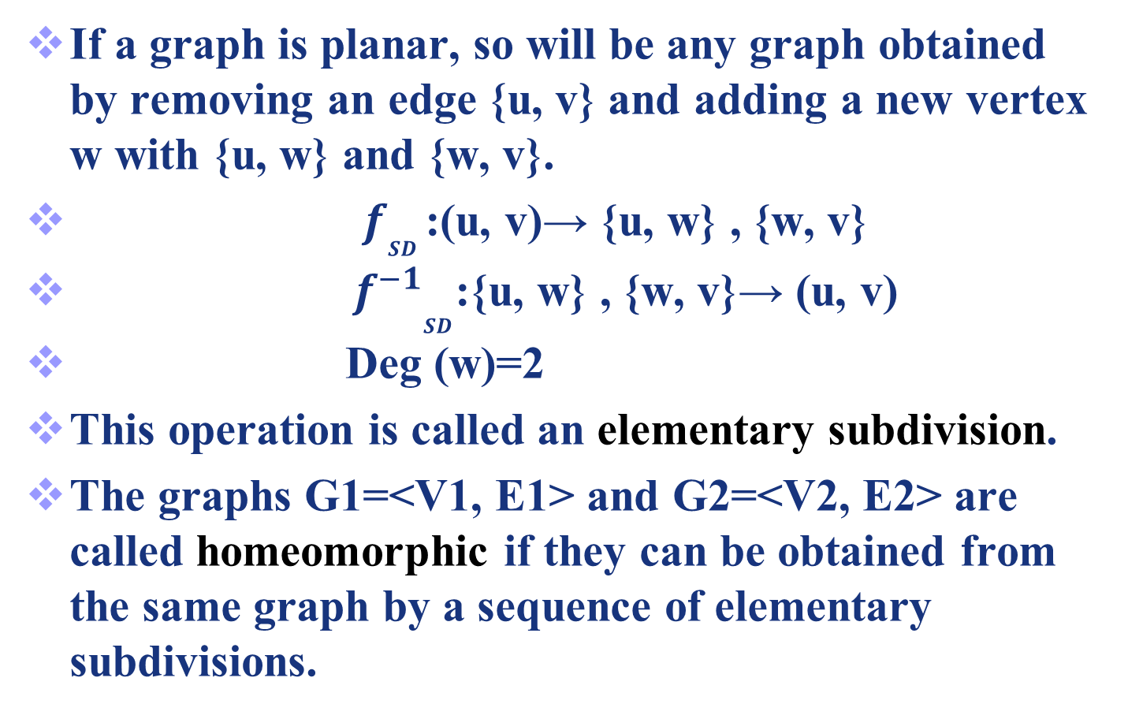
Kuratowski’s Theorem
If a graph is planar, so will be any graph obtained by removing an edge {u, v} and adding a new vertex w with {u, w} and {w, v}.
${ f}_{SD}$:(u, v)→ {u, w} , {w, v}
${{ f}^{−1}}_{SD}$:{u, w} , {w, v}→ (u, v)
Deg (w)=2
This operation is called an elementary subdivision.
The graphs G1=<V1, E1> and G2=<V2, E2> are called homeomorphic if they can be obtained from the same graph by a sequence of elementary subdivisions.
40
Notes:
已修改

Slide 41
Homeomorphic Graphs
a
G1
a
G2
b
b
f
h
g
c
e
c
e
d
d
a
G3
b
G2 and G3 are obtained from G1 by elementary subdivisions.
k
i
j
g
c
e
d
41

Slide 42
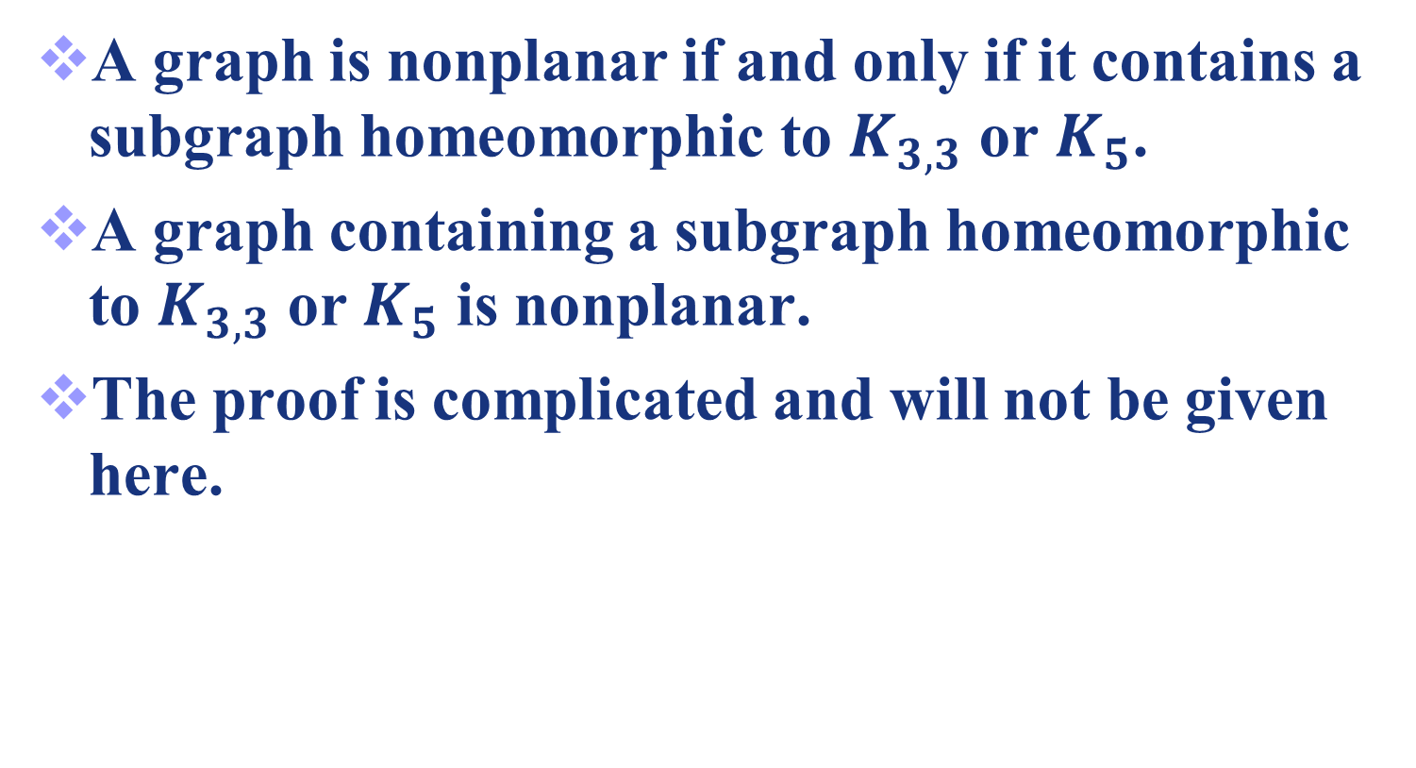
Theorem 2
42

Slide 43
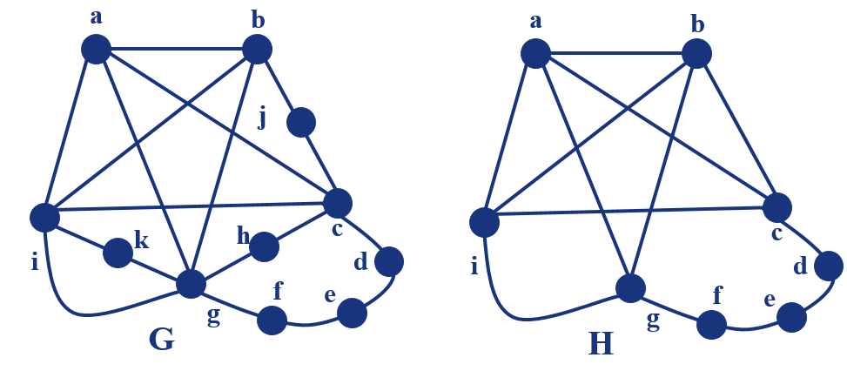
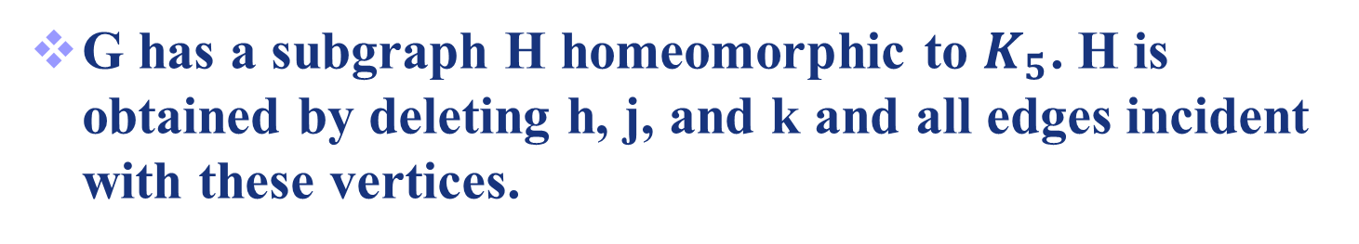
Example 7
43

Slide 44
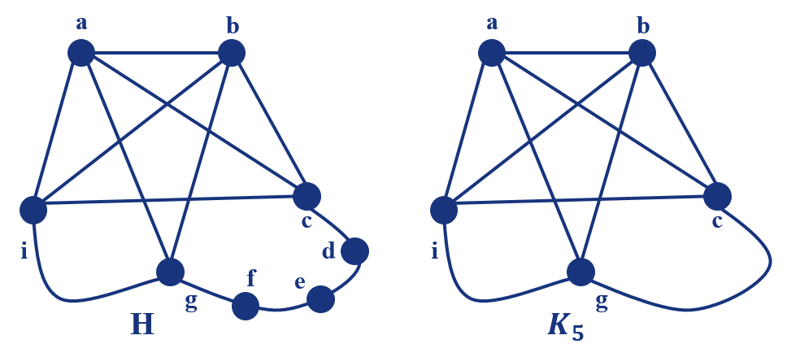
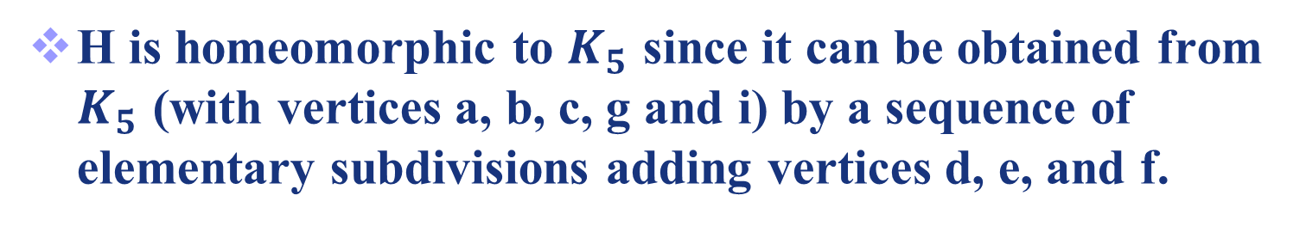
Example 7
44

Slide 45
Example 7
a
b
a
b
j
c
i
d
f
e
c
g
k
h
H
i
d
f
e
g
G
c
G is nonplanar.
i
g
K5
45

Slide 46

Example 8
a
a
e
f
e
f
b
j
g
j
g
i
h
i
h
d
c
d
c
(a’)
(a)
46

Slide 47
a
c
f
d
j
f
e
a
g
j
g
e
i
h
i
h
d
c
(a’)
(b)
b is homeomorphic to K3,3 with vertex sets {f,d,j} and {e,i,h}, since it can be obtained by deleting {d,h},{e,f} and {i,j} and adding {c,h},{c,d},{a,e},{a,f},{g,i},{g,j}.
47

Slide 48
c
f
d
j
g
a
e
i
h
(b)
deleting {d ,h}, {e, j} and {f, h} and a.
adding {d, h}, {f, h} and {j, e}.
48

Slide 49
Applications
49
49

Slide 50
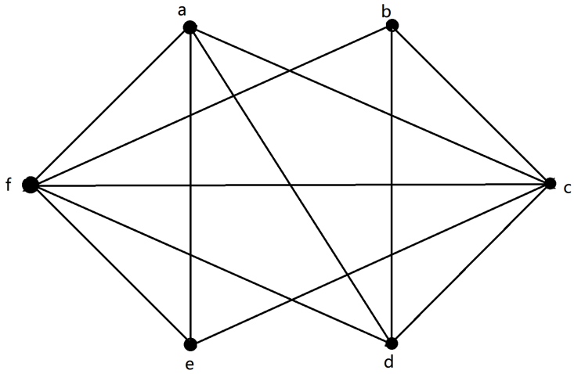
Applications
1.不带任何交叉地画出给定的平面图

Slide 51
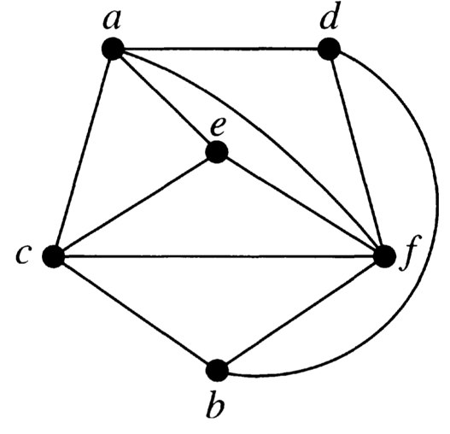
Applications
1.不带任何交叉地画出给定的平面图

Slide 52
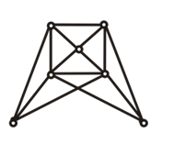
Applications
2.证明下图不是平面图
Notes:
已修改

Slide 53
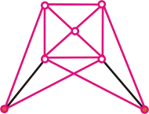
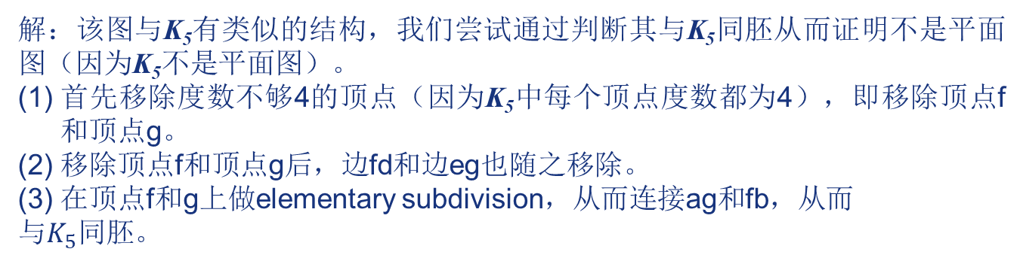
Applications
2.证明下图不是平面图
a
b
c
d
e
f
g
解：该图与K₅有类似的结构，我们尝试通过判断其与K₅同胚从而证明不是平面图（因为K₅不是平面图）。
首先移除度数不够4的顶点（因为K₅中每个顶点度数都为4），即移除顶点f和顶点g。
移除顶点f和顶点g后，边fd和边eg也随之移除。
在顶点f和g上做elementary subdivision，从而连接ag和fb，从而
与$K_{5}同胚$。
Notes:
已修改

Slide 54
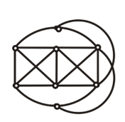
Applications
3.证明下图不是平面图
Notes:
已修改

Slide 55
Applications
3.证明下图不是平面图
a
c
d
e
f
g
h
b
解：该图与K_{3,3}有类似的结构，我们尝试通过判断其与K_{3,3}同胚从而证明不是平面图（因为K_{3,3}不是平面图）。
（1）根据K_{3,3}，应当将原图的6个顶点平均分成2组，组内的顶点互不相连，而每个顶点的度数都为3。我们分别选取点c,g,e和点f,d,h作为2组的顶点。
Notes:
已修改

Slide 56
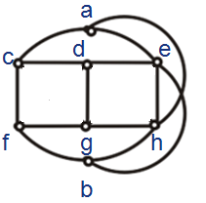
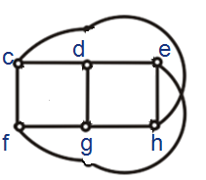
Applications
3.证明下图不是平面图
（2）由于组内顶点不相连，故删除边cg,fd,dh,ge。
（3）由于点c和点h需要相连，故移除点a和边ae。同理移除点b和边bh。
Notes:
已修改

Slide 57
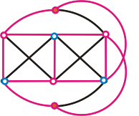
Applications
3.证明下图不是平面图
与K_{3,3}同胚，也可收缩到K_{3,3} 。由于K_{3,3}不是平面图，因此原图不是平面图
Notes:
已修改

Slide 58
Exercises
1. How many planar graphs in the following graphs? ( )
1
2
3
4
B
解析：
Notes:
已修改

Slide 59
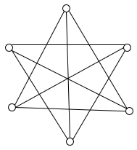
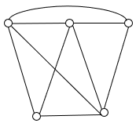
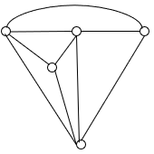
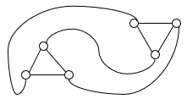
Exercises
2. Please prove that the given graphs are planar graphs
解析：
Notes:
已修改

Slide 60

Exercises
3. A planar graph with 12 vertices (each degree 3) has ______ regions.
8
解析： 由握手定理得，2e=12*3 $⟹$ e=18
由欧拉公式得，r=e-v+2=18-12+2=8
Notes:
已修改

Slide 61
Exercises
4. Suppose that a connected planar simple graph has 8 vertices, and the plane is splited into 6 regions by using planar representation of this planar graph. The sum of all vertices’ degree is _________.
24
解析：由欧拉公式：r = e – v +2
r = 6; v = 8; 得e = 12；
由握手定理：总节点度数 = 2e = 24.
Notes:
已修改

Slide 62
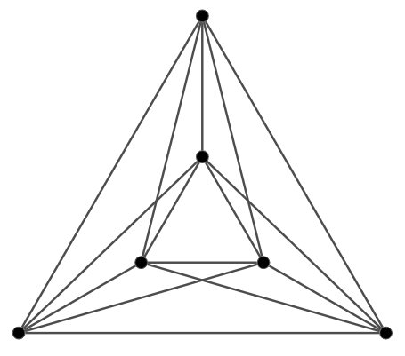
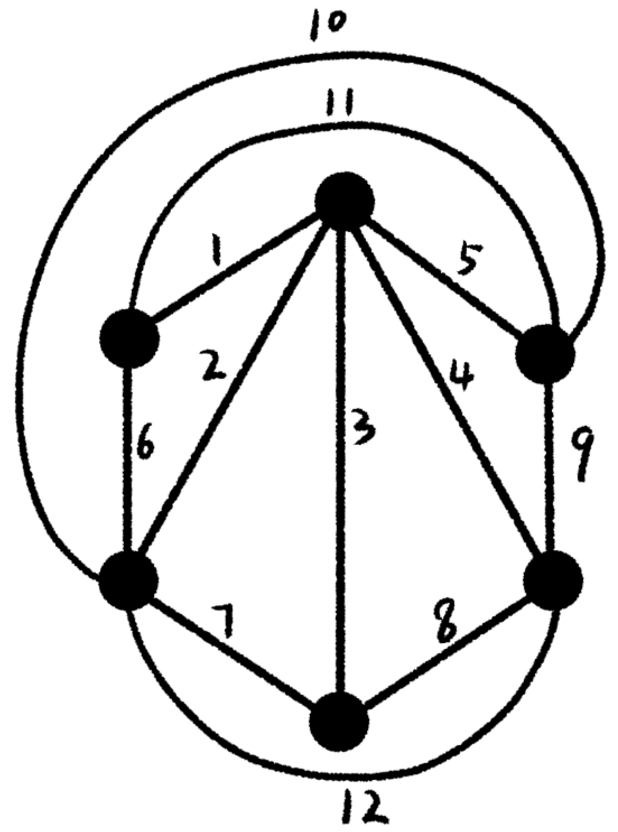
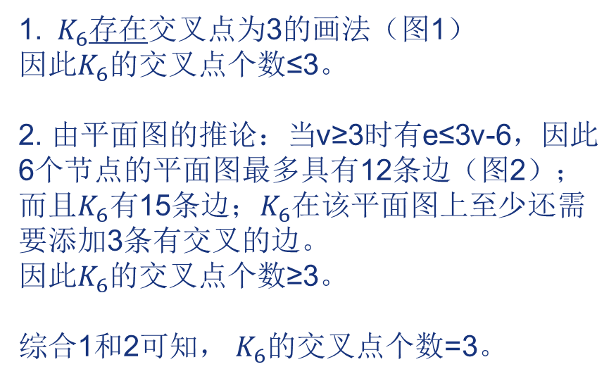
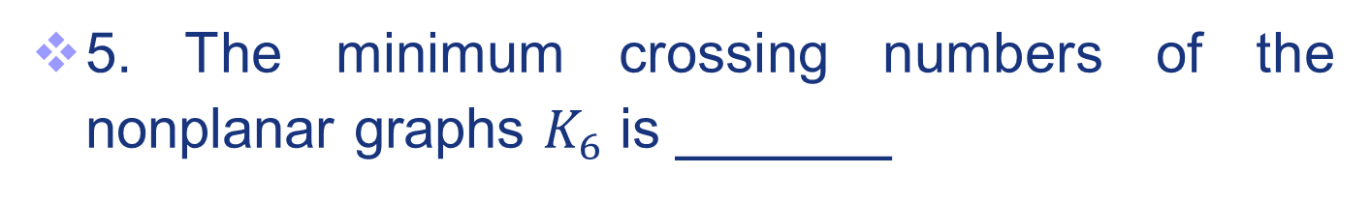
Exercises
5. The minimum crossing numbers of the nonplanar graphs $K_{6}$ is ______
3
图1
1. $K_{6}$存在交叉点为3的画法（图1）
因此$K_{6}$的交叉点个数≤3。
2. 由平面图的推论：当v≥3时有e≤3v-6，因此6个节点的平面图最多具有12条边（图2）；而且$K_{6}有$15条边；$K_{6}$在该平面图上至少还需要添加3条有交叉的边。
因此$K_{6}$的交叉点个数≥3。
综合1和2可知， $K_{6}$的交叉点个数=3。
图2
Notes:
已修改

Slide 63

Exercises
6. Such given graph is planar(P) , bipartite(B) , Euler (E) or Hamilton graph (H)? (P/B/E/H/NONE OF four to fill)
P and B
Notes:
已修改

Slide 64
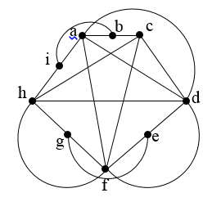
Exercises
8. Please determine whether the given graph is planar.
non planar, homeomorphic to K5

Slide 65
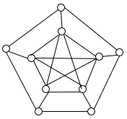
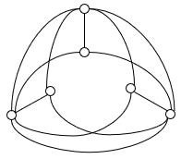
Exercises
9. Please prove that the given graphs are not planar.
First graph includes subgraph K₅, and second graph includes subgraph K_{3,3}.
Notes:
已修改

Slide 66
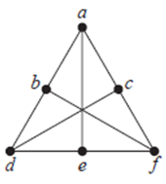
Exercises
10. Please determine whether the given graph is planar. If so, draw it so that no edges cross. If not, give your reason.
E, and V represent the number of edges and vertices of the graph
|E|=9, |V|=6,
If |V | ≥ 3 and no circuits of length 3, then |E| ≤ 2|V| − 4.
However, here |E|=9, and 2|V | − 4=8.
Thus, it is not planar.
Notes:
已修改

Slide 67
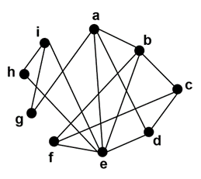
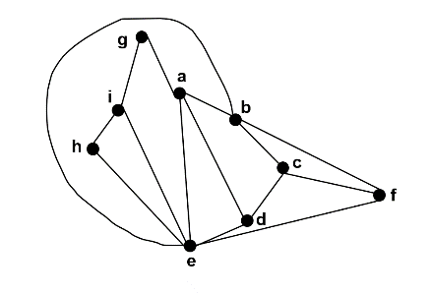
Exercises
11. Please determine whether the given graph is planar. If so, draw it so that no edges cross. If not, give your reason.
The graph has 15 edges and 9 vertices. According to corollary 1 of Euler’s formula, the inequality e<3v-6 is satisfied. Consequently, it is reasonable to try to find a planar representation of this graph.
Planar graph：This is planar.
Notes:
已修改

Slide 68
Exercises
12. Suppose that a connected planar simple graph has 15 vertices, each of degree 4. How many regions does a representation of this planar graph split the plane?
r, e, and v represent the number of regions, edges, and vertices of the graph
This graph has 15 vertices, each of degree 4, so that v = 15.
Because 2e = 15 * 4 =60, e =30.
Hence, r = e – v + 2 = 30 - 15 +2 = 17.
Notes:
已修改

Slide 69
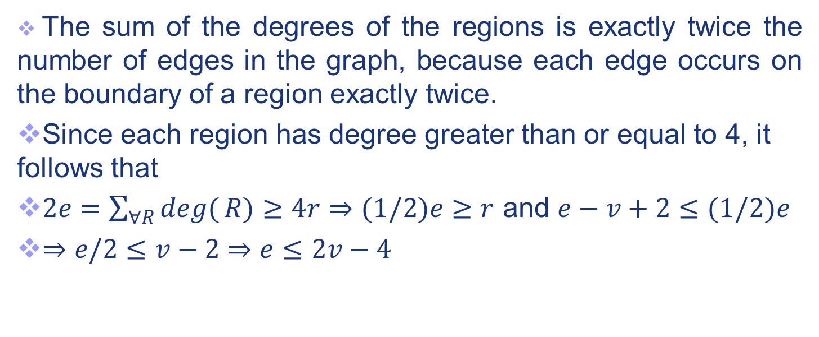
Exercises
13. Prove the theorem: If G is a connected planar simple graph has e edges and v vertices with v ≥ 3 and no circuits of length three, e ≤ 2v - 4.
r represents the number of regions
Notes:
已修改

Slide 70

Exercises
14. Suppose that a connected planar simple graph with e edges and v vertices contains no simple circuits of length 4 or less. Show that e≤(5/3)v-(10/3) if v≥4.
Proof: A connected planar simple graph drawn in the plane divides the plane into regions. The degree of each region is least 5 (Since the graphs discussed here are simple graphs contains no simple circuits of length 4 or less.)
Hence, (2/5)e ≥r. Using r=e-v+2 we obtained e-v+2 ≤(2/5)e. It follows that e≤(5/3)v-(10/3).
Notes:
已修改

Slide 71
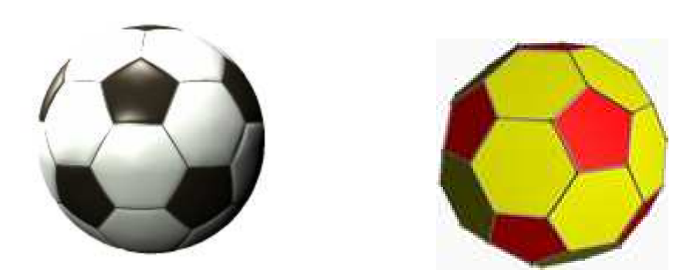
Exercises
15. The shape of a soccer ball can be represented by a polyhedron (多面体), called the truncated icosahedron(截断二十面体), whose faces are 12 regular pentagons(五边形) and 20 regular hexagons(六边形), having the same side length. Each pentagon is surrounded by 5 hexagons, whereas each hexagon is surrounded by 3 pentagons and 3hexagons.
How many sides are there?
And how many vertices?
r, e, and v represent the number of regions, edges, and vertices of the graph
Each side is shared by either two hexagons, or by one hexagon and one pentagon. There are 12 pentagons, each with 5 sides, and 20 hexagons, each with 6 sides.
Therefore, summing the number of sides of each face, we get a total of 12 · 5 + 20 · 6 = 180 edges, but each edge is being counted twice (over counting), so the actual number of edges is e = 180/2 = 90.
Now, from the Euler formula, we have that v − e + r = 2. Since e = 90 and r = 12 + 20 = 32, we conclude that there are v = 60 vertices.
Notes:
已修改

Slide 72
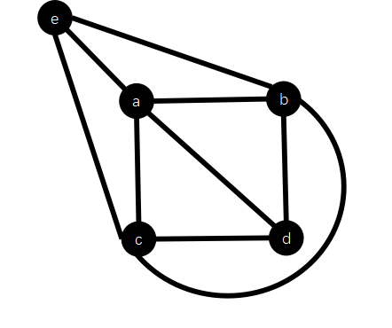

Exercises
16. Figure 5 shows a circuit schematic(电路原理图) . To implement the circuit schematic with a one-layer plane printed circuit board(PCB,电路板), please determine that whether there is a circuit layout where circuits never crossover with each other. If there exists such a layout, please illustrate it with a plane graph. Otherwise, explain the reason.
In the production process of the PCB, the machanic arm traverses all the circuit to paint the layout on the board. To reduce the production cost, please determine whether exist a traverse path for the circuit layout, so that the circuit layout could be painted with one stroke(一笔画). If there exists such a traverse path, please determine the vertices sequence of the path. Otherwise, explain the reason.
一笔画方案：首尾节点是e和d, 而且a b c d e各出现两次，有多种方案。
参考方案：e b a e c b d a c d
Notes:
已修改

Slide 73
End of Section 4.7
Click to edit company slogan .
73

